Slide 1

What Mr. Spock would possibly say about modern unit testing: pragmatic and emotional overview
Yaroslav Yermilov
Senior Software Engineer, EPAM Systems

Slide 2


About me
Yaroslav Yermilov
Senior Software Engineer, postgraduate
https://ua.linkedin.com/pub/yaroslav-yermilov/58/682/506
https://www.facebook.com/yaroslav.yermilov
https://twitter.com/yermilov17
fond of Java, complete code, big data, data science, Groovy

Slide 3
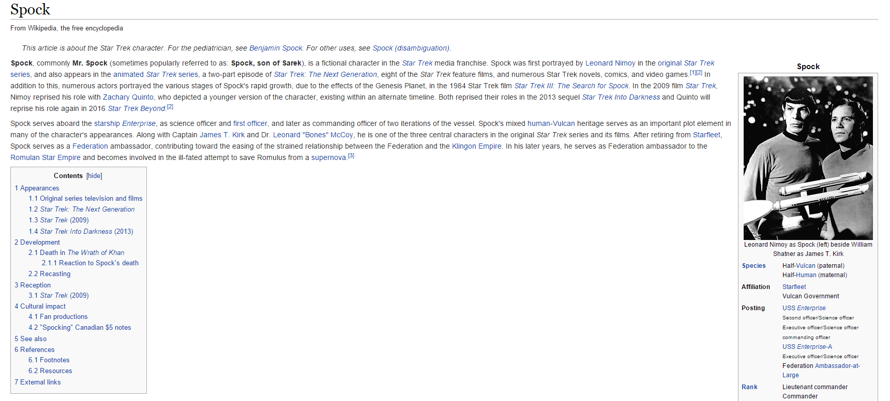
About Spock

Slide 4

Disclaimer

Slide 5

What’s the problem?

Slide 6

Better to test before going to production

Slide 7
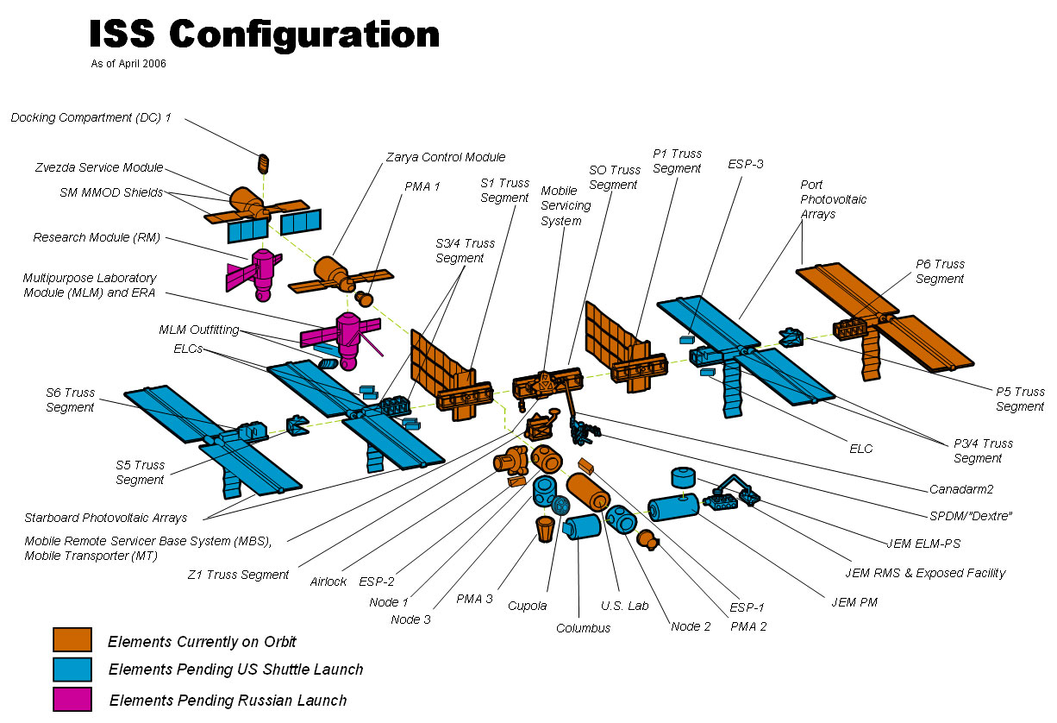
Firstly, to unit-test

Slide 8

So what?

Slide 9

JUnit?

Slide 10

JUnit on steroids?

Slide 11

TestNG?

Slide 12

Nothing?

Slide 13

Well, JUnit is great

Slide 14

But a little bit...

Slide 15
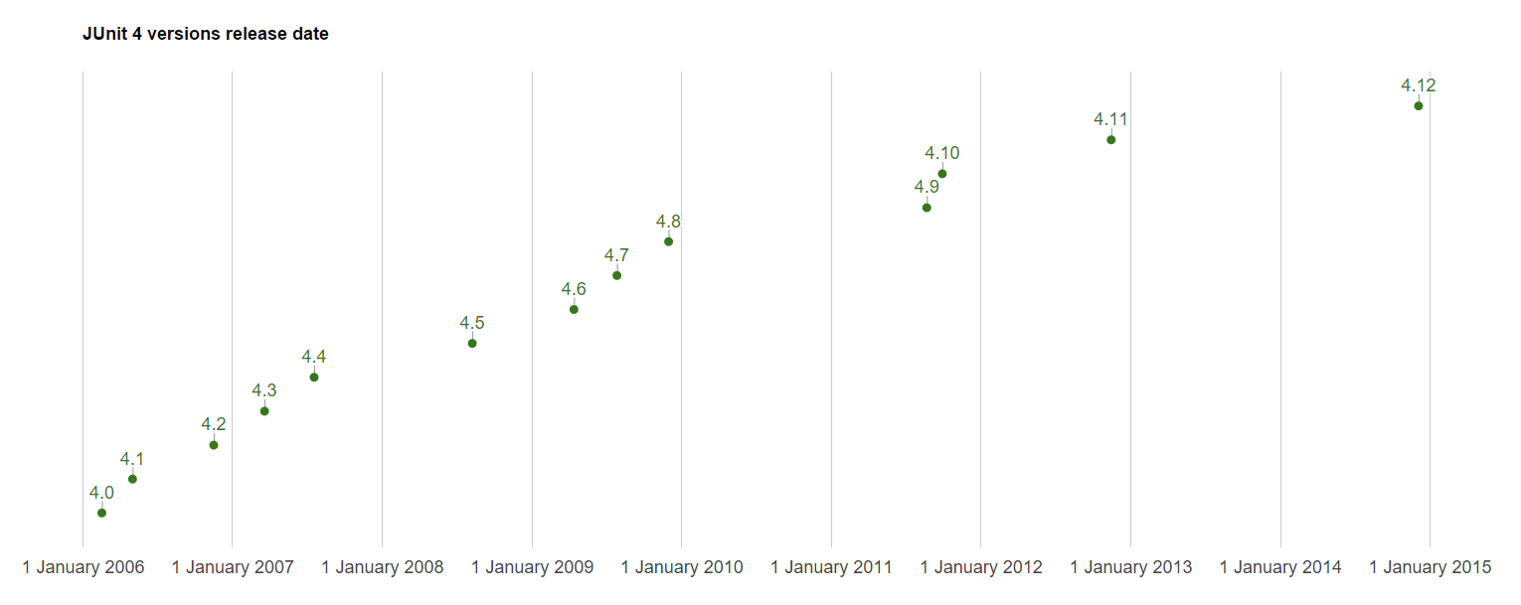
...stable?

Slide 16

So why don’t try Spock?

Slide 17
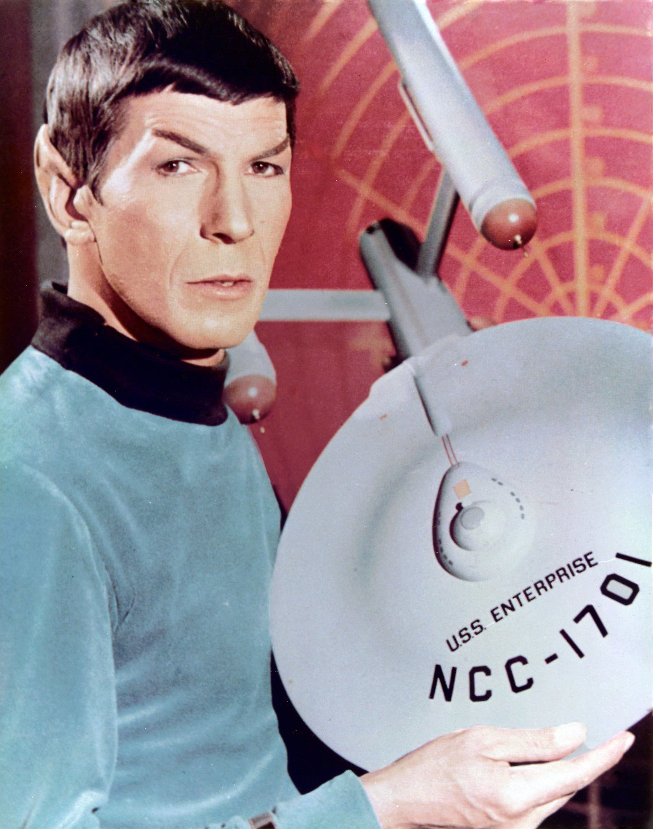
Spock is Enterprise ready

Slide 18
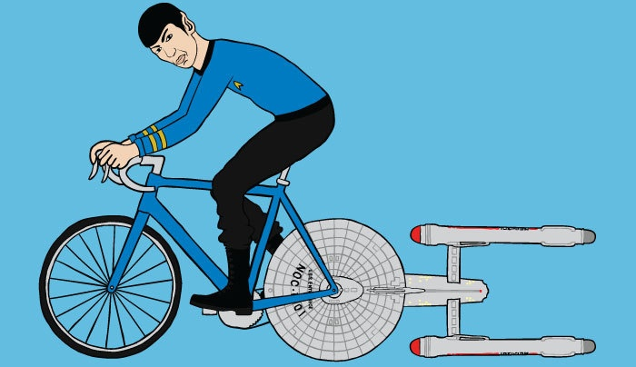
Let’s go!
https://github.com/yermilov/spock-talk

Slide 19

Episode I: Every journey starts somewhere

Slide 20
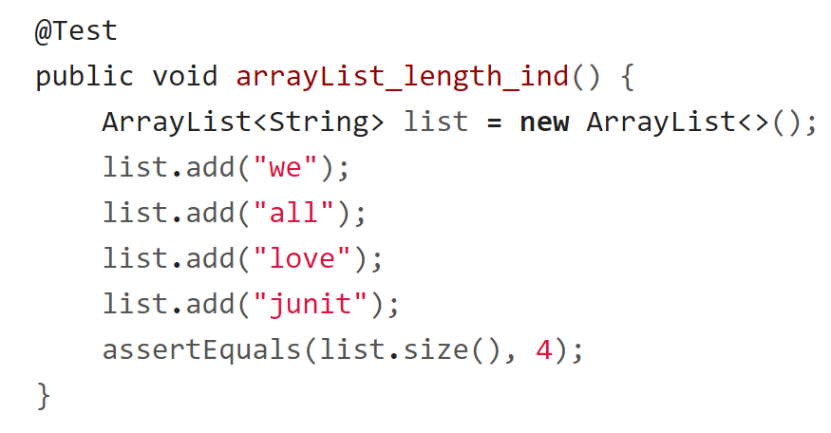
Episode I: Every journey starts somewhere

Slide 21
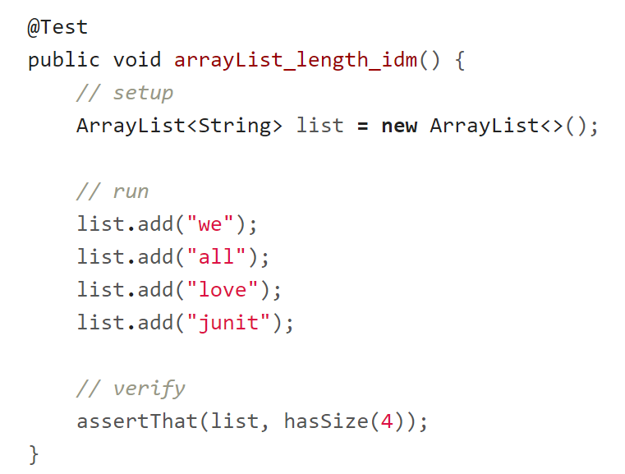
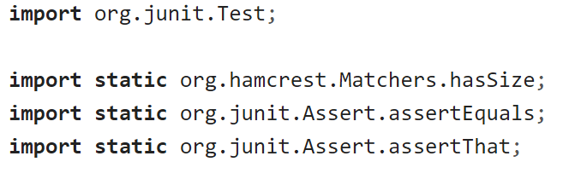
Episode I: Every journey starts somewhere

Slide 22
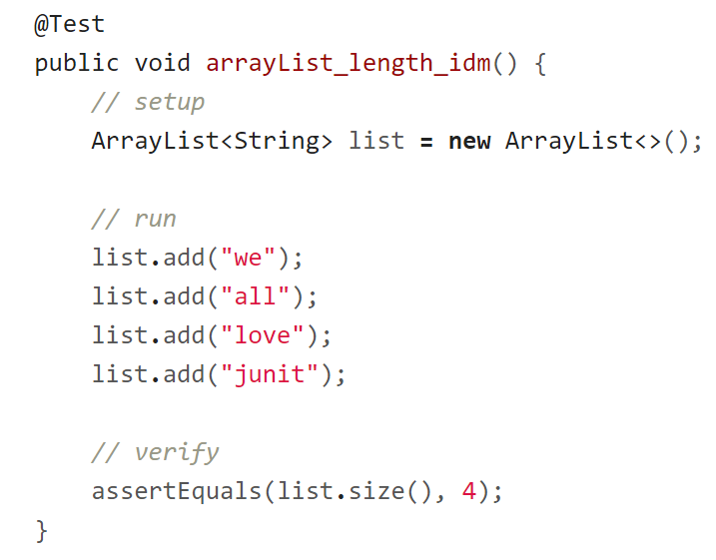
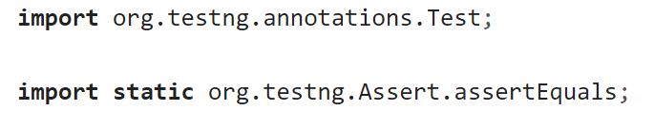
Episode I: Every journey starts somewhere

Slide 23

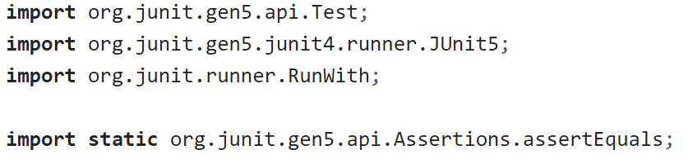
Episode I: Every journey starts somewhere

Slide 24
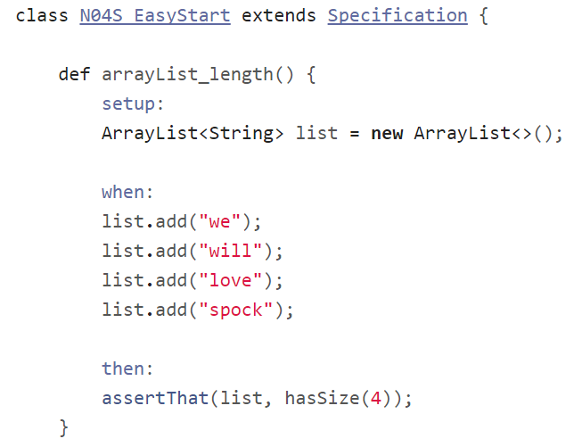
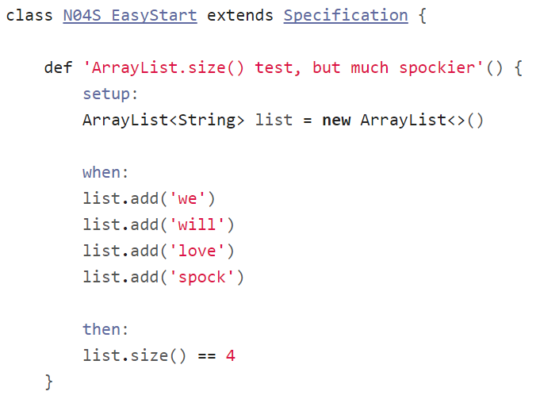
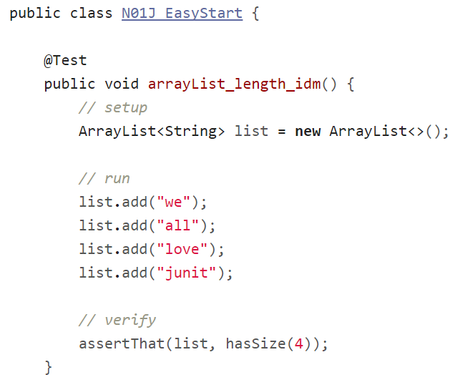
Episode I: Every journey starts somewhere

Slide 25

Episode II:
Assertions

Slide 26
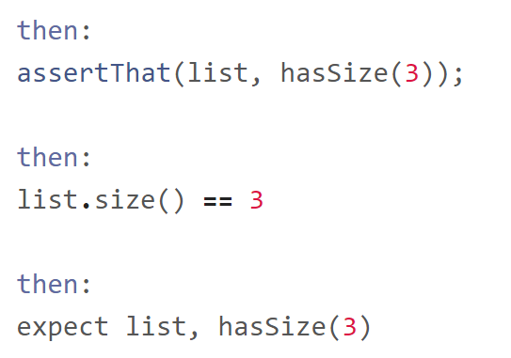
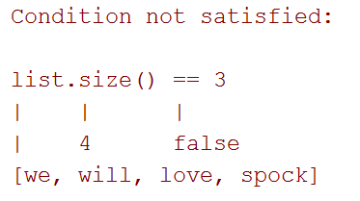
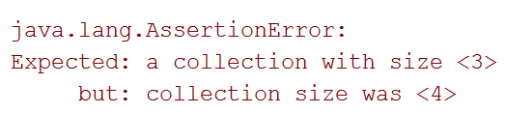
Episode II: Assertions

Slide 27
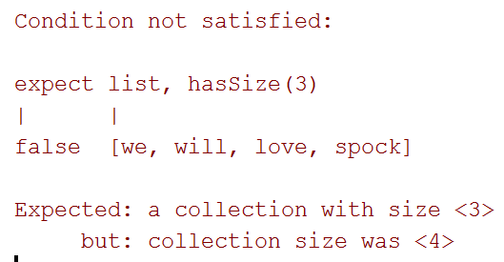
Episode II: Assertions

Slide 28
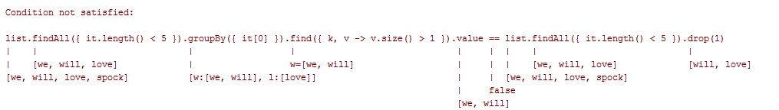
Episode II: Assertions

Slide 29
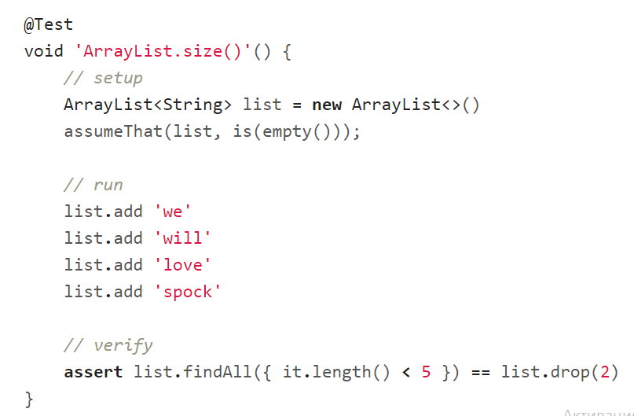
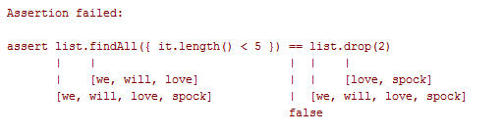
Episode II: Assertions

Slide 30
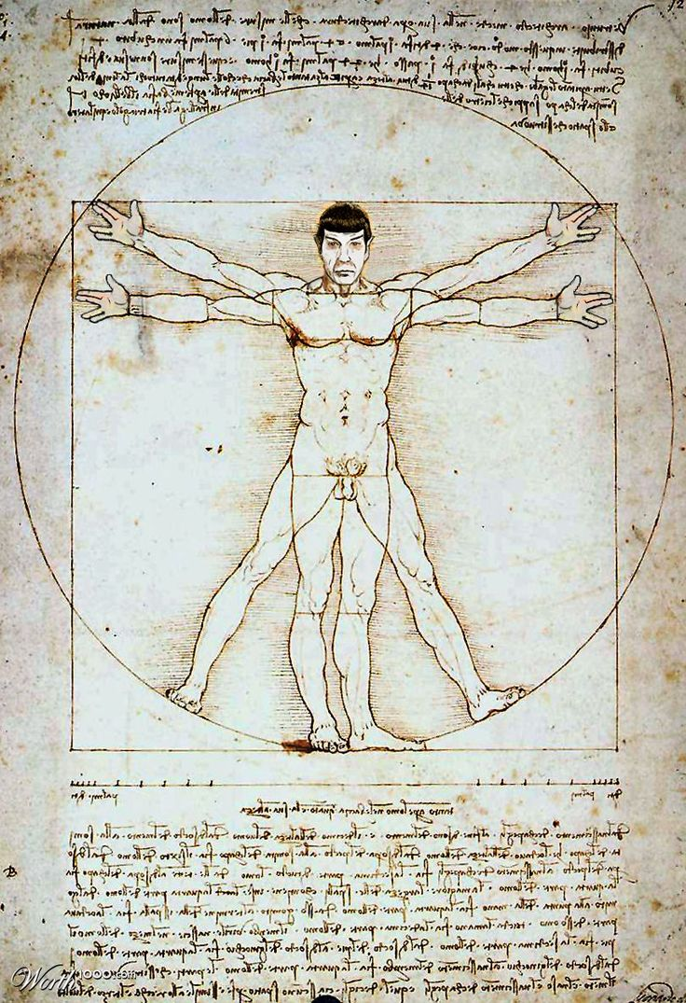
Episode III: Idiomatic Spock

Slide 31
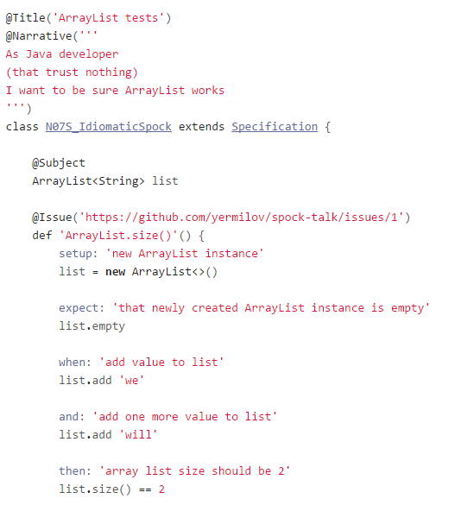
Episode III:
Idiomatic Spock

Slide 32
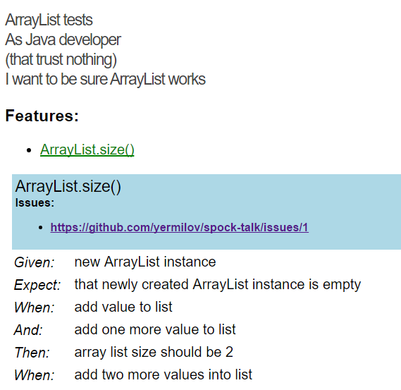
Episode III:
Idiomatic Spock

Slide 33
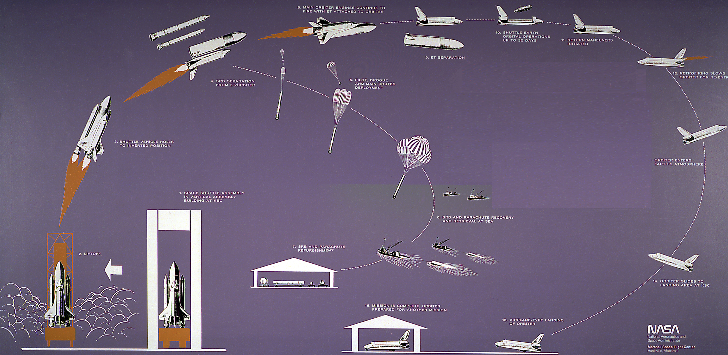
Episode IV:
Setup/Teardown

Slide 34
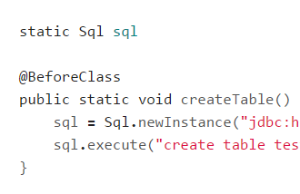
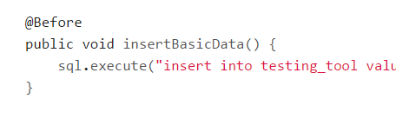
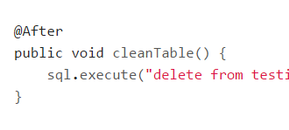
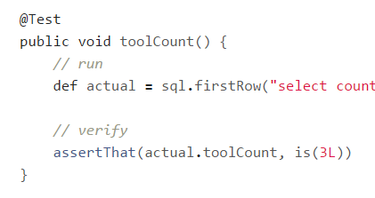
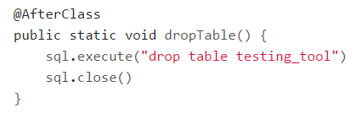
Episode IV: Setup/Teardown

Slide 35
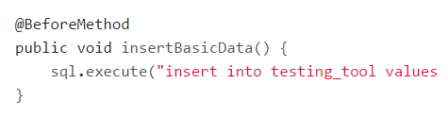
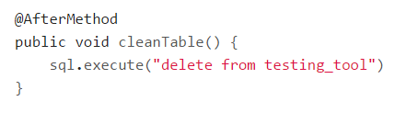
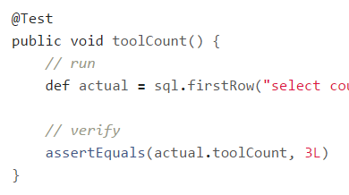
Episode IV: Setup/Teardown

Slide 36
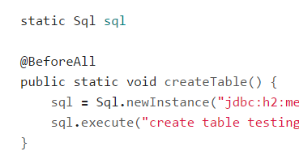
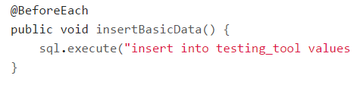
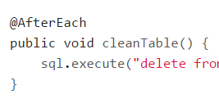
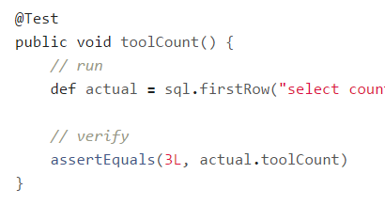
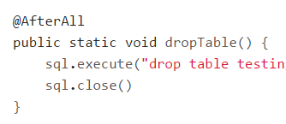
Episode IV: Setup/Teardown

Slide 37
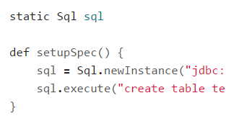
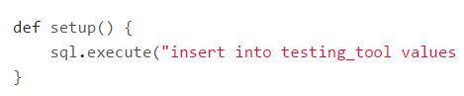
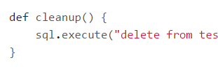
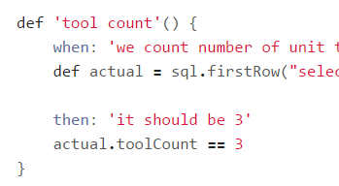
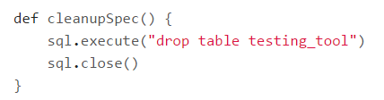
Episode IV: Setup/Teardown

Slide 38
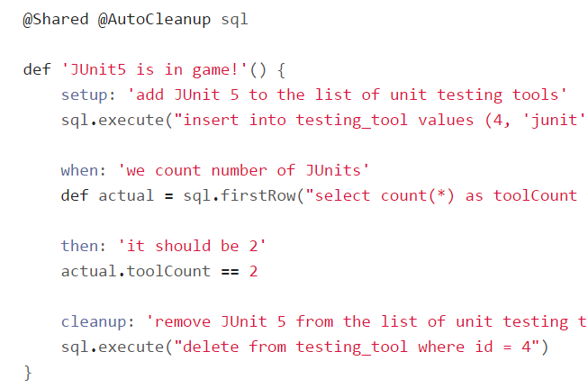
Episode IV: Setup/Teardown

Slide 39
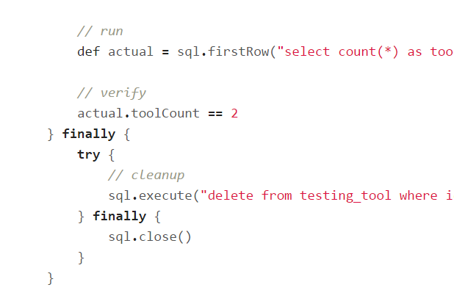

Episode IV: Setup/Teardown

Slide 40





Episode IV: @Shared or static?

Slide 41

Episode V:
Data driven test

Slide 42
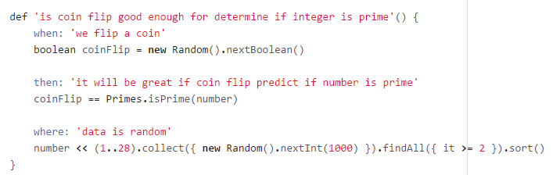
Episode V: Data driven test

Slide 43
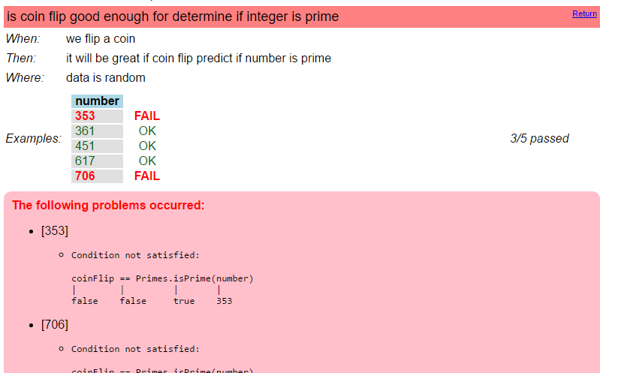
Episode V: Data driven test

Slide 44
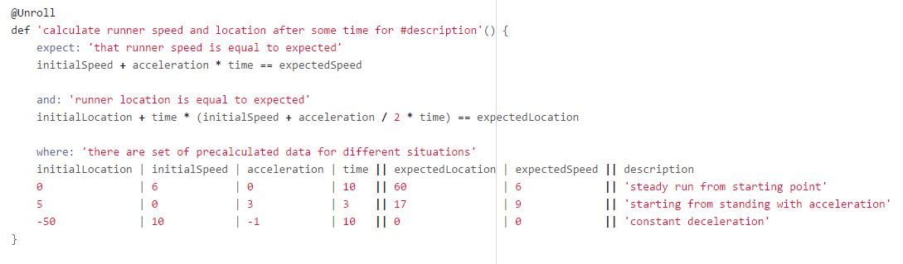
Episode V: Data driven test

Slide 45
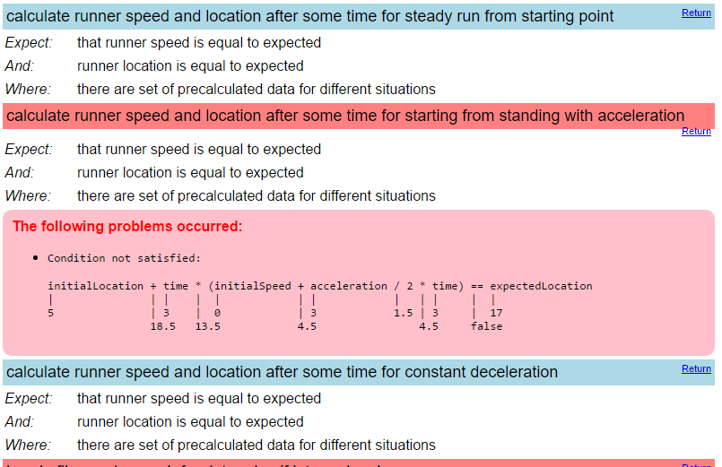
Episode V: Data driven test

Slide 46
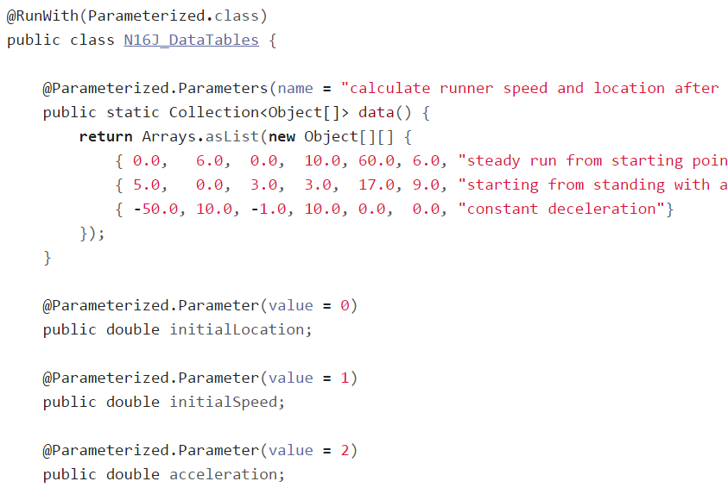
Episode V: Data driven test

Slide 47

Episode V: Data driven test

Slide 48

Episode V: Data driven test

Slide 49

Episode V: Data driven test

Slide 50

Episode VI:
Exceptions

Slide 51

Episode VI: Exceptions

Slide 52

Episode VI: Exceptions

Slide 53

Episode VI: Exceptions

Slide 54

Episode VI: Exceptions

Slide 55

Episode VI: Exceptions

Slide 56

Episode VI: Exceptions

Slide 57

Episode VI: Exceptions

Slide 58

Episode VI: Exceptions

Slide 59

Episode VI: Exceptions

Slide 60

Episode VII:
Mocks,
Stubs,
Spies

Slide 61



Episode VII: Mocks, Stubs, Spies

Slide 62



Episode VII: Mocks, Stubs, Spies

Slide 63



Episode VII: Mocks, Stubs, Spies

Slide 64


Episode VII: Mocks, Stubs, Spies

Slide 65

Episode VII: Mocks, Stubs, Spies

Slide 66

Episode VIII: Time travel

Slide 67

Episode VIII: Time travel

Slide 68

Episode VIII: Time travel

Slide 69

Episode VIII: Time travel

Slide 70

Episode VIII: Time travel

Slide 71

Episode VIII: Time travel

Slide 72

Episode VIII: Time travel

Slide 73

Episode VIII: Time travel

Slide 74

Episode VIII: Time travel

Slide 75

Episode IX:
Test control

Slide 76

Episode IX: Test control

Slide 77

Episode IX: Test control

Slide 78

Episode IX: Test control

Slide 79

Episode IX: Test control

Slide 80

Episode IX: Test control

Slide 81

Episode IX: Test control

Slide 82

Episode IX: Test control

Slide 83

Episode IX: Test control

Slide 84

Episode IX: Test control

Slide 85

Episode X: Encore

Slide 86

Episode X: Encore

Slide 87

Why one should use Spock?

Slide 88

Concise syntax

Slide 89

Language for testing instead of testing struggling language

Slide 90

Clear test structure

Slide 91

Code and reports readable for everyone

Slide 92

Powerful built-in features

Slide 93

Extensions

Slide 94

Useful for unit, integration and functional tests

Slide 95

Behaves as one more JUnit runner

Slide 96

Works for both Groovy and Java

Slide 97

When one can use Spock?

Slide 98

Your team is ready to make one step forward

Slide 99

You are about to start new project

Slide 100

You want to cover legacy project with unit tests

Slide 101

You want to introduce functional testing in your project

Slide 102

Why one should not use Spock?

Slide 103

JUnit/TestNG has 90% similar/imitable features

Slide 104
When one should not use Spock?

Slide 105

What’s next?
http://spockframework.github.io/spock/docs/1.0/index.html
http://meetspock.appspot.com/
https://github.com/spockframework
Just use it in your projects and enjoy!

Slide 106

Thanks!

